Slide 1
AdaBoost Algorithm
A Comprehensive Guide to Adaptive Boosting

Slide 2
What is AdaBoost?
Short for Adaptive Boosting.
A machine learning meta-algorithm used to improve the performance of other algorithms.
Works by combining multiple weak classifiers to create a strong classifier.

Slide 3
Key Concepts
Boosting
Technique to convert weak learners to strong ones.
Sequentially applies the weak learner on modified versions of the data.
Weak Learners
Classifiers that perform slightly better than random guessing.
Examples: Decision stumps, small decision trees.

Slide 4
How AdaBoost Works
Initialize Weights
All training examples start with equal weights.
Train Weak Learner
Fit a weak learner to the training data.
Calculate Error
Evaluate the weak learner’s performance and calculate the error.
Update Weights
Increase weights of incorrectly classified examples, decrease weights of correctly classified examples.
Repeat
Iterate steps 2-4 for a predefined number of rounds or until a desired error rate is achieved.
Combine Weak Learners
Combine all weak learners into a final strong classifier.

Slide 5
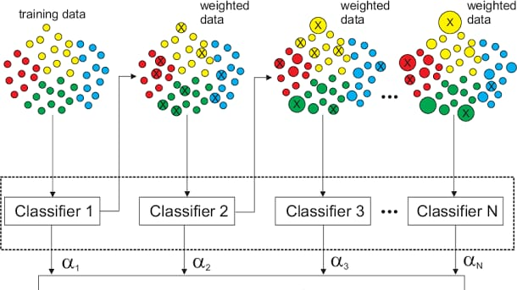
VISUALISATION

Slide 6
Advantages of AdaBoost
Robust to overfitting.
Simple to implement.
Works well with a variety of classifiers.
Efficient: Focuses on hard-to-classify examples.

Slide 7
Disadvantages of AdaBoost
Sensitive to noisy data and outliers.
Performance depends on the choice of weak learners.
Can be slower compared to other algorithms due to sequential nature.

Slide 8
Applications
Face detection
Text classification
Customer churn prediction
Medical diagnosis

Slide 9
Conclusion
AdaBoost is a powerful ensemble technique.
Effective for various machine learning tasks.
Enhances the performance of weak learners.
Future Directions
Integration with deep learning.
Advanced variants and improvements.

